Slide 1


INFOSYS SPRINGBOARD INTERNSHIP 5.0
TumorTrace: MRI-Based AI for Breast Cancer Detection
NAME:SIVA NANDINI BOMMUPALLA
ROLE:AI/ML INTERN

Slide 2

PROBLEM
Statement
Objective: Early detection of breast cancer is crucial for improving survival rates. Manual analysis of MRI scans is time-consuming and prone to human error.
Challenge: Automating the classification of breast tumors (Benign vs. Malignant) using machine learning to enhance diagnostic accuracy and reduce time.
Impact: Assisting radiologists with quick and reliable predictions.

Slide 3
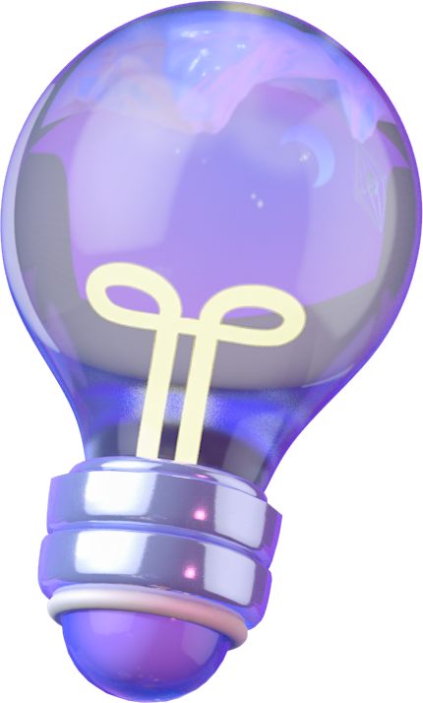
DATASET
Train Set: 20,434 images
Validation Set: 1,989 images
Test Set: 6,851 images
Labels: Benign Malignant
Dataset Split: The dataset is split intotraining (70%)
validation (10%),and testing (20%),
ensuring adequate representation of both labels across each
subset.

Slide 4
DATA PREPROCESSG
Data Cleaning: Removal of corrupted or low-quality images.
Data Augmentation: Applied techniques like rotation, flipping, scaling, and brightness adjustment to increase dataset size and variability.
Resizing: Standardized image dimensions for model compatibility.
All images were resized to a fixed dimension of (224 x 224) pixels to match the input size required by the ResNet18 mode
Normalization:Pixel values, originally ranging from 0 to 255, were scaled to a range of 0 to 1 by dividing by 255

Slide 5

FEATURE ExtractiOn Techniqes
1.Histogram of Pixel Values
2.Gray-Level Co-Occurrence Matrix (GLCM) Properties
3.Histogram of Oriented Gradients (HOG)
4. Sobel Operator
5. Local Binary Pattern (LBP)
6. Multi-Variance Median LBP (MVM-LBP)

Slide 6
VGG16
VGG16 is a widely recognized and successful convolutional neural network (CNN) architecture known for its simplicity and effectiveness in image classification tasks.
The network has 16 layers, enabling it to learn detailed hierarchical features, critical for distinguishing subtle differences in MRI images of benign and malignant tumors.
It performs well on moderately complex datasets like medical images.
The pre-trained model adapts to the tumor classification task effectively.
Convolutional layers of VGG16 extract low-level to high-level features like edges, textures, and complex patterns critical in medical imaging.

Slide 7


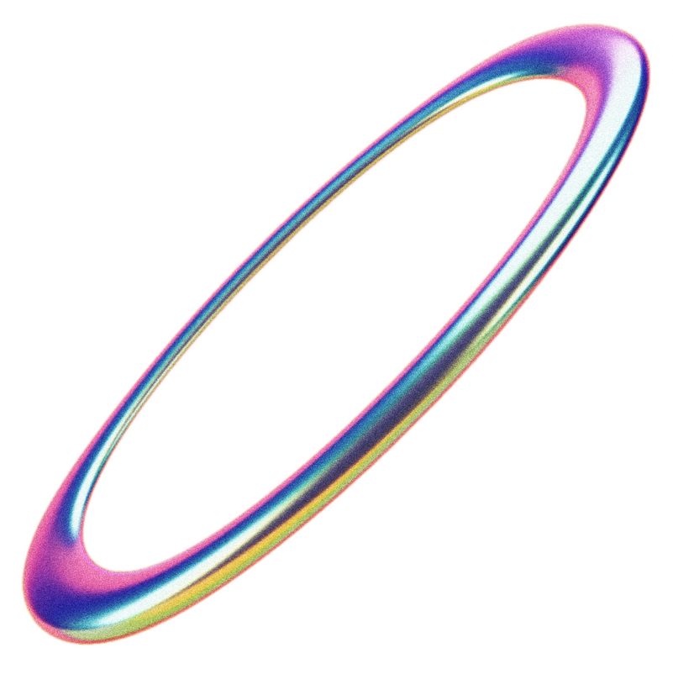

RESNET18
ResNet18, a lightweight version of the ResNet family, introduces residual connections, which address the vanishing gradient problem and allow for deeper networks without degrading performance.
Key Featuresand Modifications:
Pre-trained Base: The backbone ResNet18 model, pre- trained on ImageNet, is used for feature extraction.
Custom Fully Connected Layer:
The final fully connected layer was replaced with a custom layer to match the number of classes (2 for this project).
Advantages:
Residual connections improve gradient flow and learning.
ResNet18 is computationally efficient, making it suitable for faster training on systems without GPUs.
Why Use This Model:Offers a balance between performance and computational cost.
Works effectively even with relatively smaller datasets, as it prevents overfitting by design

Slide 8



RESNET50
ResNet50, a deeper version of ResNet18, extends the capacity of the networkto learn more complex patternsand features, thanks to its 50-layer architecture.
Key Featuresand Modifications:
Pre-trained Base: Like ResNet18, the pre-trained ResNet50 model on ImageNet is used as the starting point.
Custom Fully Connected Layer:
The original fully connected layer was replaced with one suitable for binary classification.
Advantages:
Depth allows capturing more abstract features in the data.
Residual connections make it robust to the vanishing gradient issue, despite its depth.

Slide 9
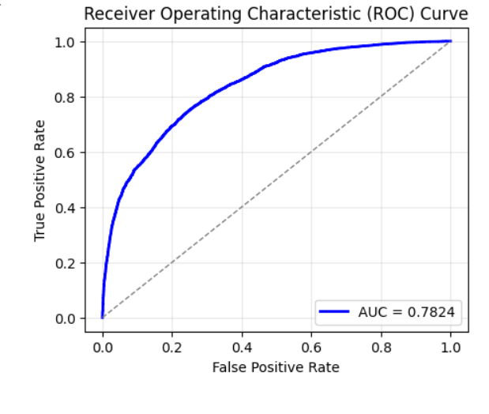
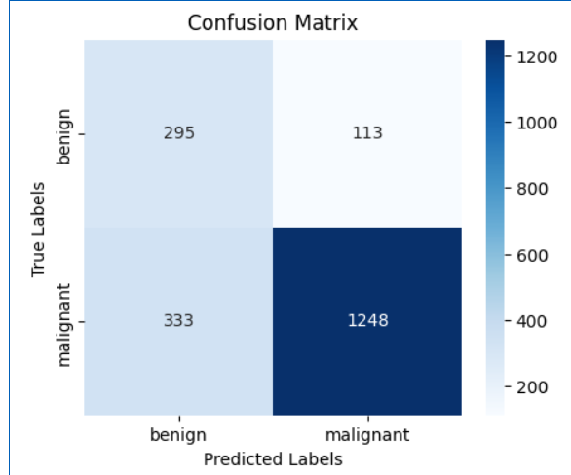
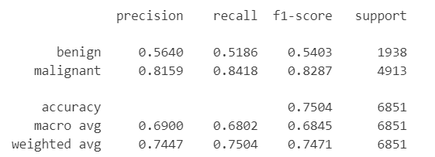
Result VGG16
Home
Service
About Us
Contact
Confusion Matrix:
[[1005 933]
[ 777 4136]]
Specificity: 1.0000
Sensitivity: 0.0000
AUC: 0.7824
test set:
Average loss: 0.5217,
Accuracy: 5141/6851 (75.04%)

Slide 10
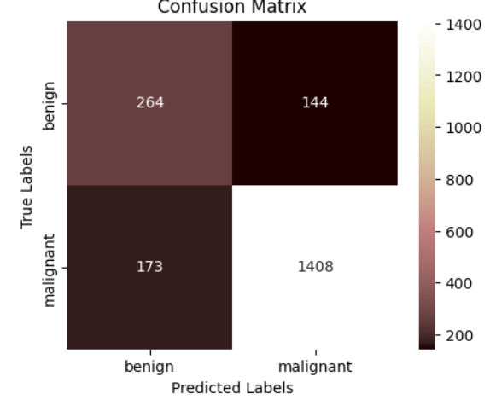
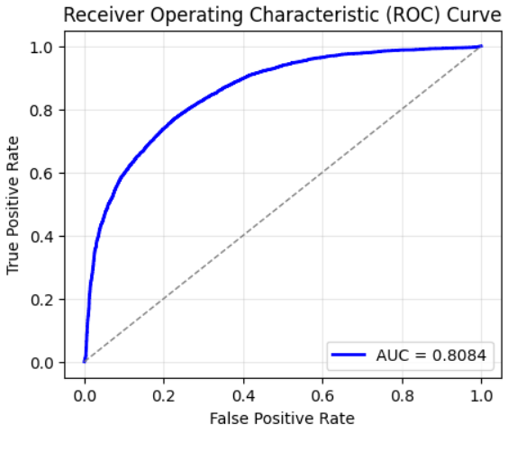
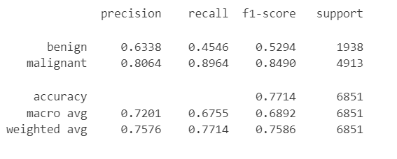
Result RESNET18
Home
Service
About Us
Contact
Confusion Matrix:
[[ 881 1057]
[ 509 4404]]
Specificity: 1.0000,
Sensitivity: 0.0000,
AUC: 0.8084
test set: Average loss: 0.6559
Accuracy: 5285/6851 (77.14%

Slide 11
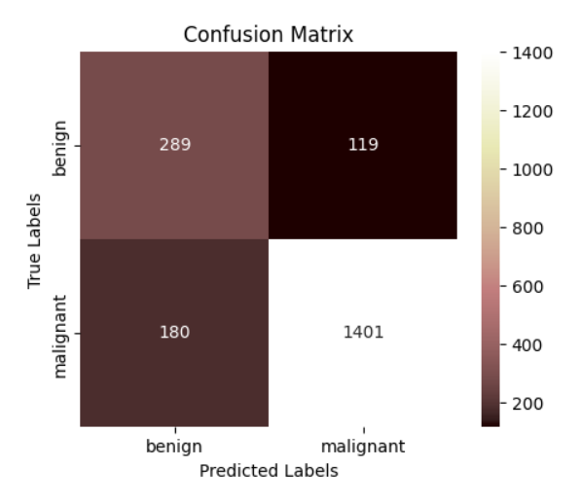
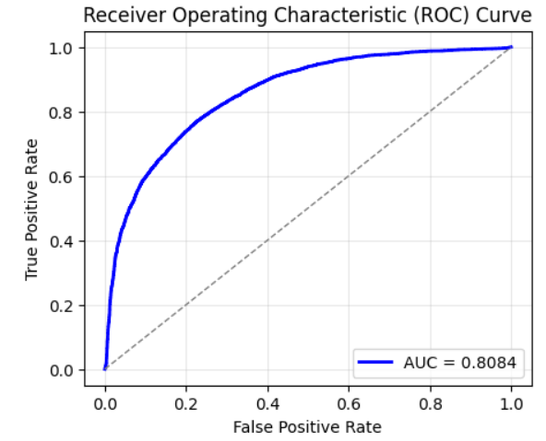
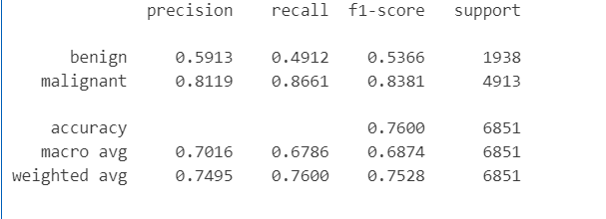
Result RESNET50
Home
Service
About Us
Contact
Confusion Matrix:
[[ 952 986]
[ 658 4255]]
Specificity: 1.0000,
Sensitivity: 0.0000,
AUC: 0.7912
test set:
Average loss: 0.6254,
Accuracy: 5207/6851 (76.00%)

Slide 12
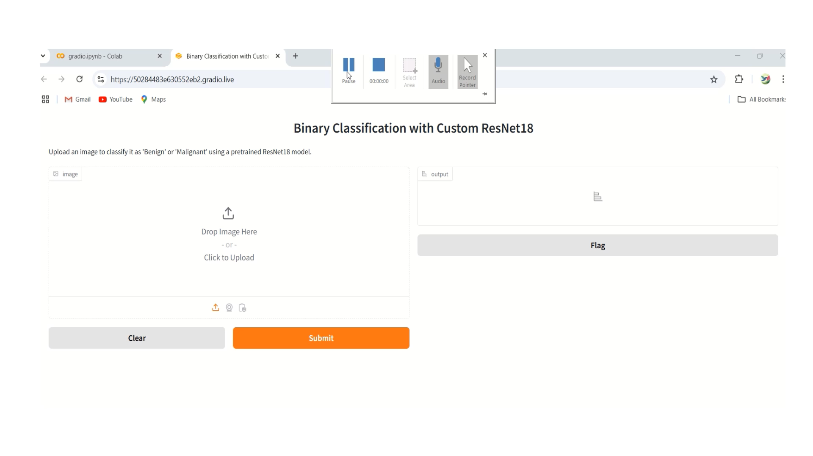

GRADIO IMPLEMENTATION

Slide 13
THANK YOU!
FOR YOUR ATTENTION

